Slide 1
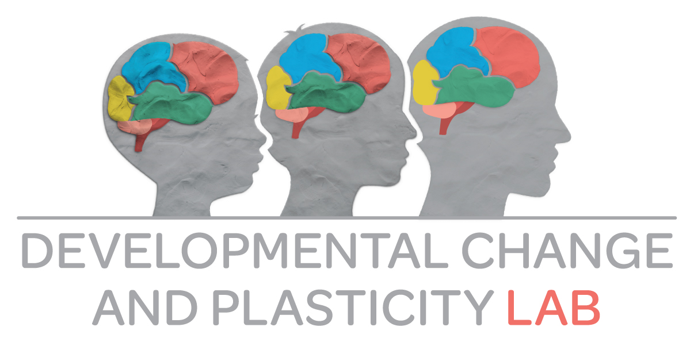
Fostering resilience in childhood
Nikolaus Steinbeis

Slide 2
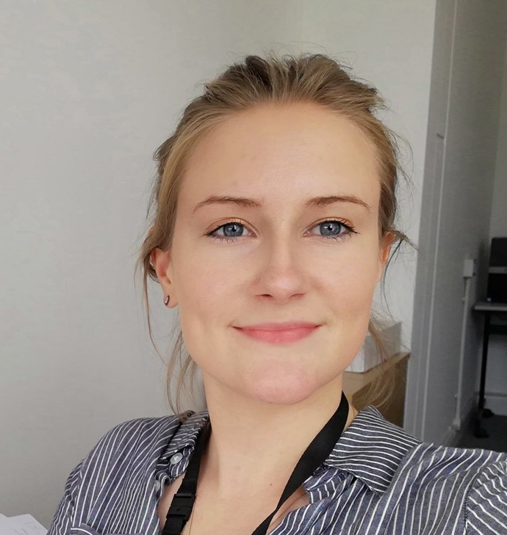
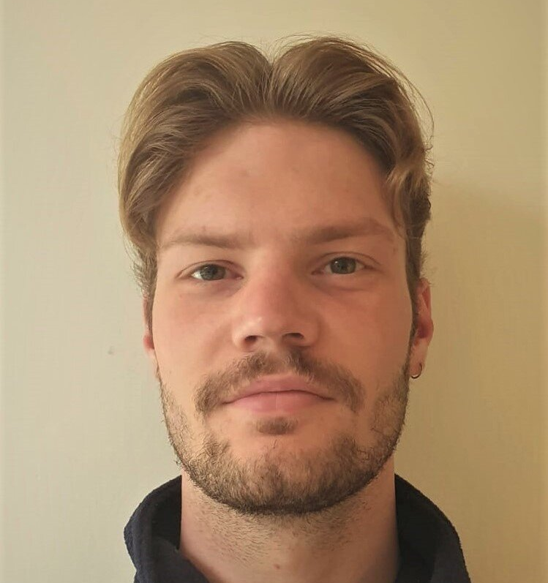
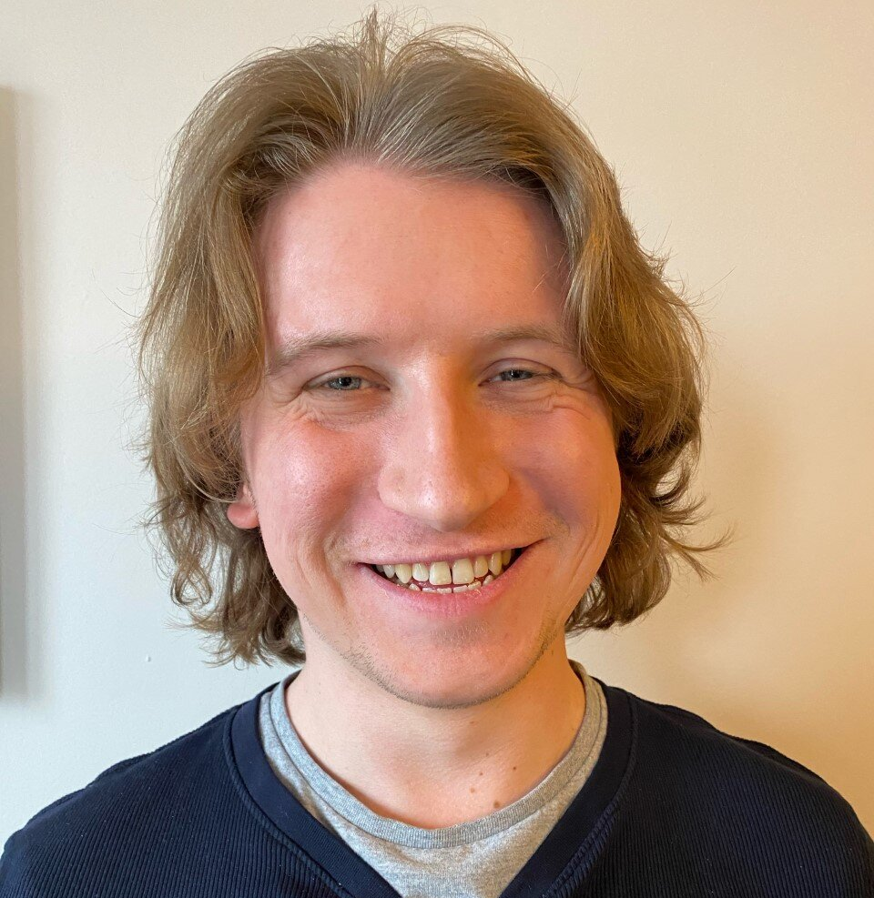
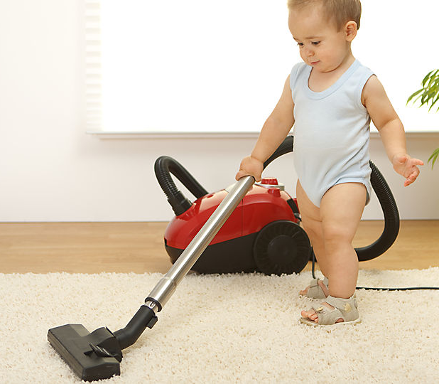
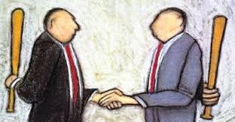
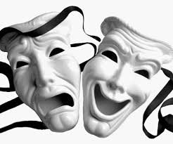
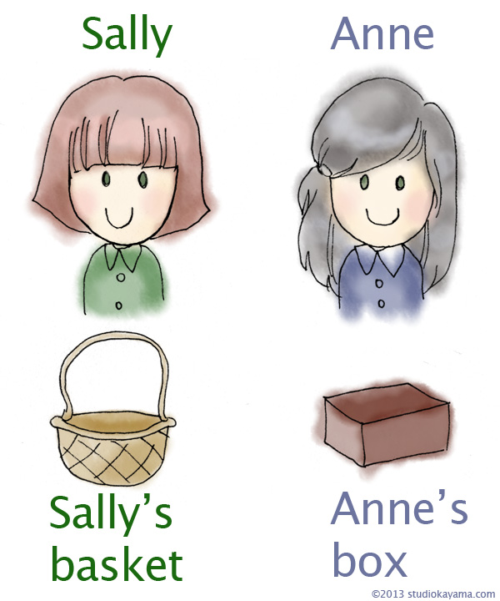
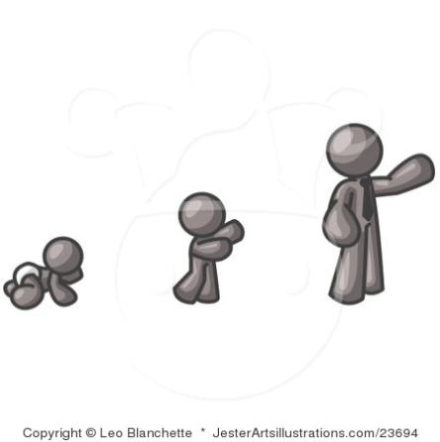
Who are we?
Understanding Others
Decision-Making
Executive Functions
Self-Control
Agency
Well-being /
Mental Health
Notes:
My main research focus is on understanding the nature and mechanisms underlying development. Particularly, social and affective development. So, if you look at the enormous leaps social development does during the first year from
- first signs of social communication in the form of social smiles
To joint attention around 8 months
To the first instances of prosocial behavior around 18 months in the form of altruistic helping
To the attribution of mental states to others even when they conflict with our own
To all the highly complex social behavior in adults, such as negotiations, cheating on one another or highly complex social emotions such as guilt or shame

Slide 3
Resilience
“Maintaining good mental health despite exposure to physical or psychological adversity” (Kalisch et al., 2017)
Maltreatment
Illness
Loss of spouse
….
Ability, capacity – fixed individual characteristic
Nothing to do with being inert or unresponsive, but the result of active, dynamic adaptation - process
Notes:
I have come to talk to you about resilience today. So I’d like to start giving you a working definition. That’s what most things boil down to in science. A recent one being that resilience refers to maintaining good mental health despite exposure to physical or psychological adversity. Adversity can take many forms – such as maltreatment or bullying, illness, tragic life events like death of a spouse; and these are just examples. Adversity can come in many forms and it is very much also about how it is subjectively perceived. So resilience then describes the phenomenon that some of us continue to do well in spite of having experienced something stressful or negative; and further, while others are negatively impacted by this. Why is that?
What resilience research is about. Trying to understand what makes some of us resilient and more so, how knowing this can help us foster it.

Slide 4
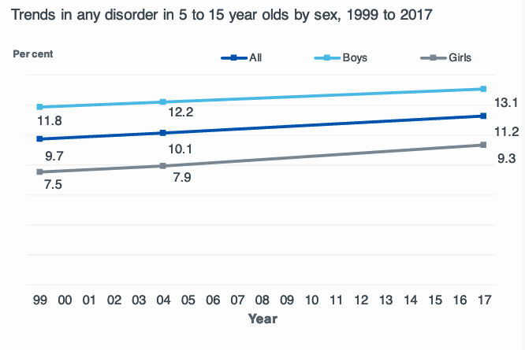
State of children’s mental health in the UK
12.8% of children aged 5-19 suffer from some for of mental health illness (Public Health England, 2016)
Emotional disorders (i.e. Depression, Anxiety)
Behavioral disorders (i.e. Conduct problems)
Slight but steady increase in mental health problems over last 20 years
In 2022 - 18%
Universities report a fivefold increase in mental health conditions since 2007 (Gunnell, 2018)
NHS National Survey, 2018
Notes:
Why would we need to think about this in the first place.
So, here is some data on the state of mental health of children in the UK.
https://digital.nhs.uk/data-and-information/publications/statistical/mental-health-of-children-and-young-people-in-england/2017/2017

Slide 5
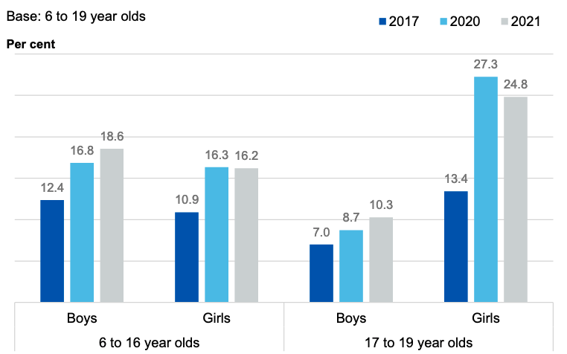
State of children’s mental health in the UK since Covid
Since March 2020
Repeated lockdown
Reduced social contact
Reduced opportunities for learning
Increased burden on families
Loneliness
Quality of sleep
NHS National Survey, 2021

Slide 6
Emergence of mental health disorders
Negotiating more complex changes
Academically
Socially
developmentally
Casey et al., 2014 (Science)

Slide 7
The role of stress
Stress plays a critical role in this development
Increased pressure at schools (i.e. SATS, GCSEs)
Social media
Covid-related stress
Persistent and / or severe stress leads to
Neurochemical effects
Learning, memory, emotion regulation
Cummulative
Subjective
Notes:
And while there are genetic risk factors for mental health problems that we have little control over, the fact that stress plays such an important role means that we should try to understand this as best we could, including what is helpful during stressful times – leading to resilient responding.

Slide 8
Supporting positive development
Well-being / Mental Health
Adolescence
Age
Notes:
Why am I talking about stress. Well, because it’s real and because we care about protecting or even more importantly helping our children how to adequately deal with stress. And because it is important thinking about this during childhood, given that we want to set our little ones up for a lifetime of positive development.
I think this is incredibly important!

Slide 9
What is the research on resilience?
Adversity is not something you can study prospectively
Isolated a few factors in terms of how we deal with stress
Biological, genetic
Emotion regulation - reappraisal

Slide 10
Reappraisal
Ability to change the emotional meaning and impact of a situation that elicits the emotion
“It wasn’t that important anyway”; ”Tomorrow is another day”;
Children as young as 5 years have been shown to be able to do this (Willner et al., 2022)
Vignettes or videos with emotional content (usually negative)
Asked to try to see things differently and report on how they feel
Reappraisal can be taught (Denny & Ochsner, 2014)
Whether there is systematic increase and how this buffers against onset of mental health problems currently investigated

Slide 11
Stressor control
Plethora of animal work showing that while not having control over a stressor (i.e. pain) produces depressive phenotype (i.e. learned helplessness) having control inoculates against later stress (Seligman and Maier, 2016)
The experience of stressful events not as threatening but as challenges is crucial
Hinges on attitude and coping resources
Notes:
Lots to learn from animal models – not always the case, but when it comes to stress, it is. Because the physiology and neural pathways involved in responding to stress are remarkably conserved. So, there is a real opportunity for insight in doing comparative work directly, or in studying animal models and seeking to make inferences as to what this can mean for us.

Slide 12
Feeling in control
Believing oneself not in control is a hallmark of affective disorders such as depression and anxiety (i.e. learned helplessness)
Subjectively experienced efficacy is a strong determinant how we perceive threats
“I am in control of my life”
Predicts how well one bounces back from stressful life events

Slide 13
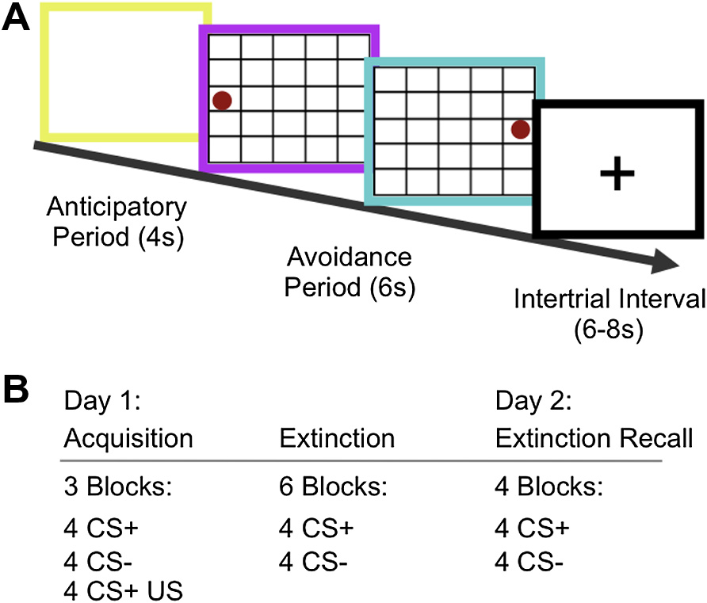
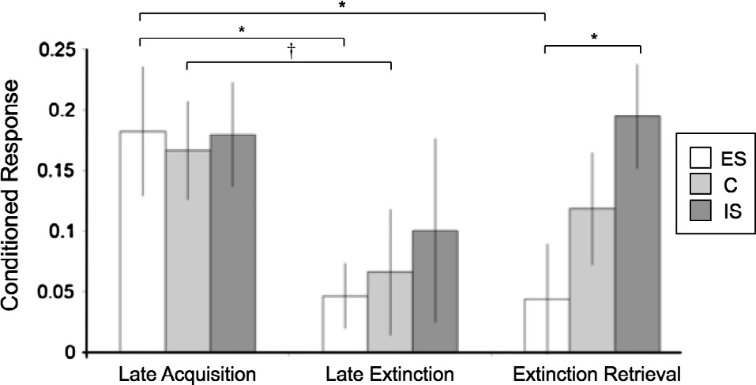
Feeling in control – a case study
102 participants (75 female; age range: 18-50 years) divided into three groups of ES, yoked IS and no stress
Stress was created by administering pain (electrical shocks) every two seconds until goal state was reached (ES)
Participants who had learned on at least a third of trials were considered to have learned
Fear learning and extinction performed with painful stimuli
Hartley et al., (2014)

Slide 14
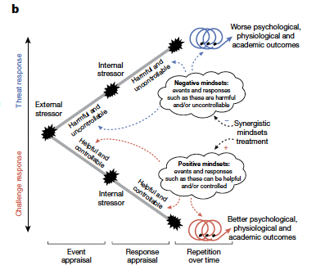
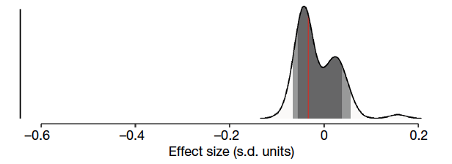
Mindset intervention (Yeager et al., 2022)
Negative self regard
Diurnal cortisol
Online 30 minute intervention targeting two beliefs:
Intelligence can be developed
Stress can fuel optimal performance
Over 3000 adolescents took part and they looked at effect on
Stress-related thoughts
Cortisol (stress hormone)
Well-being and mental health
General anxiety during Covid
Notes:
Control group – 30 minutes of information about the brain and memory; and basic information about the body’s stress response system
So, this is incredibly hopeful, because it suggests that reappraisal, especially when applied to something stressful and highlighting that stressors can be controlled has a really powerful effect on mental health, and in response to stressors, such as Covid.

Slide 15
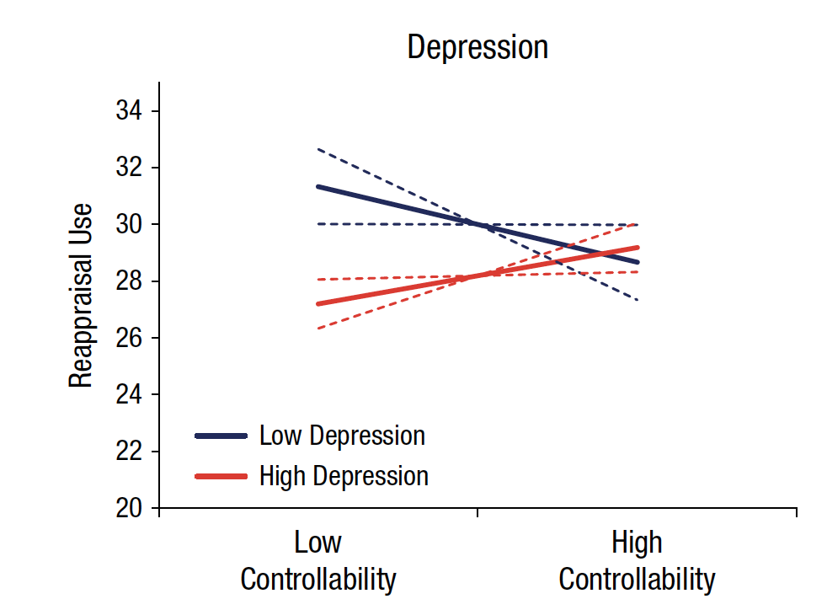
Strategy-situation fit
Different types of coping strategies
Emotion (i.e. reappraisal: “It doesn’t matter anyway”)
Situation (i.e. active coping: “How can I fix this?”)
Whether reappraisal is actually helpful depends on whether the situation / problem is controllable or not
Only in uncontrollable situations
In controllable situations would be better to act, but reappraisal removes that urgency
Using reappraisal in situations that are controllable is a risk factor for mental health problems
Haines et al., 2015
Notes:
Very important interplay between the occurrence of stress, how in control we feel about it, and what we do about it.

Slide 16
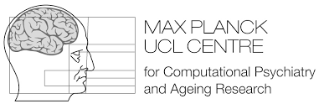
Current research focus of my lab
How does children’s subjective sense of control come about?
Why is it important for resilience?
Can we use this to foster resilience?
Part of a larger research programme

Slide 17
Step 1: What does the study involve?
How does children’s subjective sense of control come about?
How is related to mental health?
How in control do you feel?
How stressed are you?
7-11 years
A week during second half of Lent Term
30 minutes before or after school

Slide 18
Personal and data safety
Data
Will be handled anonymously
According to UCL’s and UK’s data protection laws and GDPR compliant
Will be used for grant applications and publication
Our Team
Experienced
DBS-checked

Slide 19
If you would like to be involved…
We will provide information about the study in the newsletter in due course with an email
Send message expressing interest and you will be sent information letter and consent form and a link to where you can sign up for a particular slot during the testing week
Will provide more information after half-term

Slide 20
What does everyone get out of it?
6
Experience is lots of fun for
for the children
Making a contribution to science
Knowing this is essential for devising interventions
Benefit to society and mental health

Slide 21
Take Home
Research on resilience is needed urgently
Working with children has enormous promise to improve lifelong positive trajectories
Some strategies are effective and could work in children
Reappraisal
Boosting a sense of control
Improving strategy-situation fit
Our team is running a research project on resilience and needs your help.

Slide 22
... for your attention!

