Slide 1
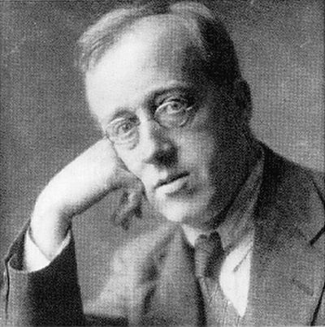
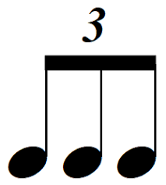
Key skills
Listening & Singing:
‘Spaceship Jam’
Holst: ‘Mars’
Composing:
In groups, create a
‘Moonscape’ composition.
Performing:
‘Spaceship Jam’
‘Mars’ ostinato
Refine and perform team blues composition to the class.
JOURNEY INTO SPACE
Music Y5
Vocabulary
ostinato
rhythm
march
structure
crotchet
quaver
triplet
time signature
orchestra
Key Facts and Knowledge
An ostinato is a short pattern repeated throughout a piece of music.
‘Mars’ uses an ostinato.
Gustav Holst composed the orchestral suite ‘The Planets’ 1914-1917.
A suite is a group of individual pieces.
There are seven pieces in ‘The Planets’ suite, ‘Mars, the bringer of war’
is the first piece.
Holst composed ‘Mars’ in anticipation of WWI
Holst lived in Barnes and taught music at St Pauls’ Girls School.
Links to prior learning
and next steps:
Y4 Painting with Sound
Y5 Cyclic Patterns
Events and extra curricular
Harvest Festival
5 4
Links to other subjects:
Y5 Learning Theme: Space
Characteristics of effective musician
I can… clap and play an ostinato; draw a picture in response to listening to music; write a rhythm pattern;
listen to and identify descriptive features in music; compose and perform a team piece ‘Moonscape’ including an ostinato;
listen and comment on others work; review and reflect own composition.

